Slide 1


DevRev
AI AGENT 007:
Tooling Up for Success
Team 69

Slide 2
Problem Statement
For a Language model L powered up with a set of tools T, it can be used to answer the domain-specific query Q by providing the appropriate subset of tools and arguments to answer the query.

Slide 3
APPROACH
LEARNING
NON-LEARNING
VS
Scarcity of Large amounts of Data for Training the Neural Networks
Not compatible with Dynamic Tool-Set
No Training is required
Compatible with the Dynamic Tool Set.

Slide 4
Non-Learning Approach
This approach revolves around the embedding-matching mechanism and finding the cosine similarity between the embeddings of the query and the tool descriptions at the upper level.

Slide 5
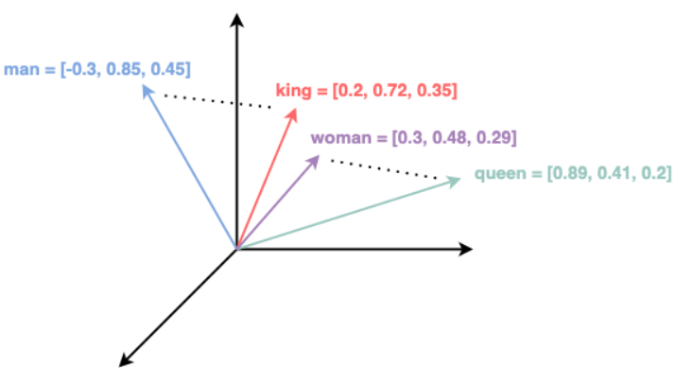
Embeddings & Cosine Similarity
Embeddings: numerical representation of text.
Text represented as points in vector space.
Cosine-Similarity: to capture the semantic relationship.

Slide 6
METHODOLOGY:
Tool-Set Processing
Query Processing
Tool Extraction
Getting Argument Values
Generating Response

Slide 7
Tool-Set Processing
Transforming the given tool description table into a JSON format file.
The sentence embedding for each tool and argument description is calculated and stored for each of the embedding model used.

Slide 8
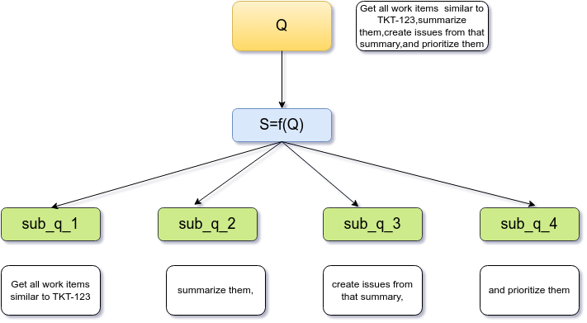
Query Processing
We Created the Split function S using the SPACY module for splitting the given query Q into sub-queries.
Splitting helped in localizing the information.

Slide 9
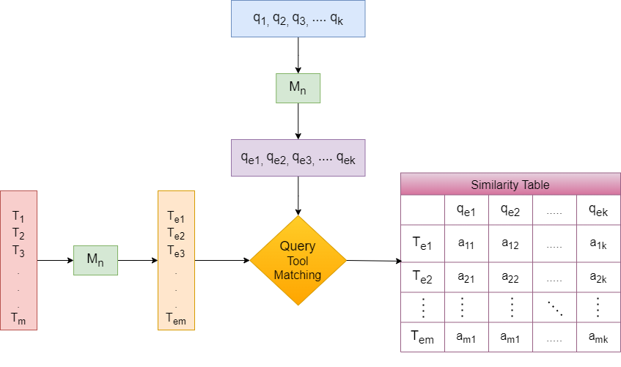
Tool Extraction
First we take the descriptions of tools and subqueries and compute their embeddings using multiple models.

Slide 10
Tool Extraction
Then we create a table which contains cosine similarity scores of each sub-queries against each tool description.

Slide 11
Tool Extraction
In each and every table, tool with maximum score is chosen for each sub-query. The same process is repeated for multiple transformer models ,to capture different features for the same sub-query

Slide 12
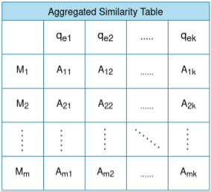
Tool Extraction
Finally a voting mechanism is applied across tables to get final tool for each sub-query

Slide 13
WHY MULTIPLE MODELS?
The cosine similarity between the embeddings of the same sub-text using different models was much less than 1, indicating different models capture information differently.
The voting mechanism for tool selection can be applied in this ensemble like-approach to remove the bias of one model for a particular tool.
Helped in resolving the near misses and conflicts.

Slide 14
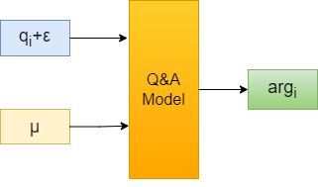
Argument Value Extraction
The BERT-based Question Answering Model is used to get the argument values from the subquery.
INPUT:
Context: subquery (qᵢ) and ε: custom-designed string
Question: µ
OUTPUT: Argument value (argᵢ)

Slide 15
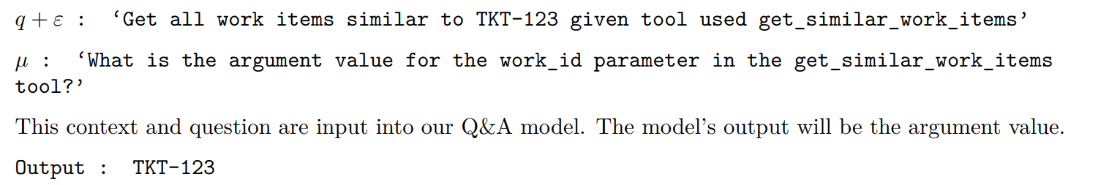
Generating Appropriate Context and Question using prompt engineering

Slide 16
GENERATING RESPONSE
&
RESULTS

Slide 17
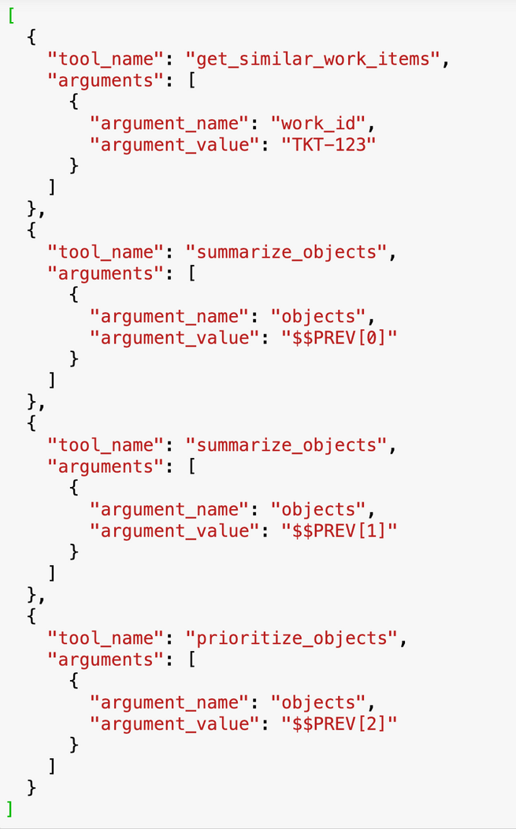
Our Results
Desired Results
“Get all work items similar to TKT-123, summarize them, create issues from that summary, and prioritize them”.

Slide 18
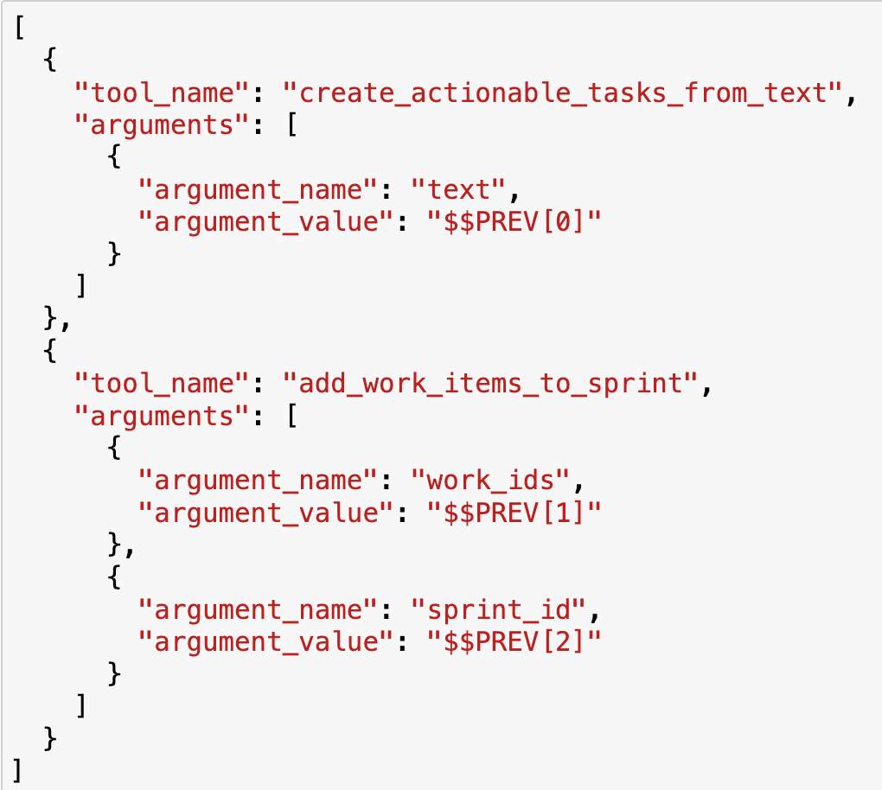
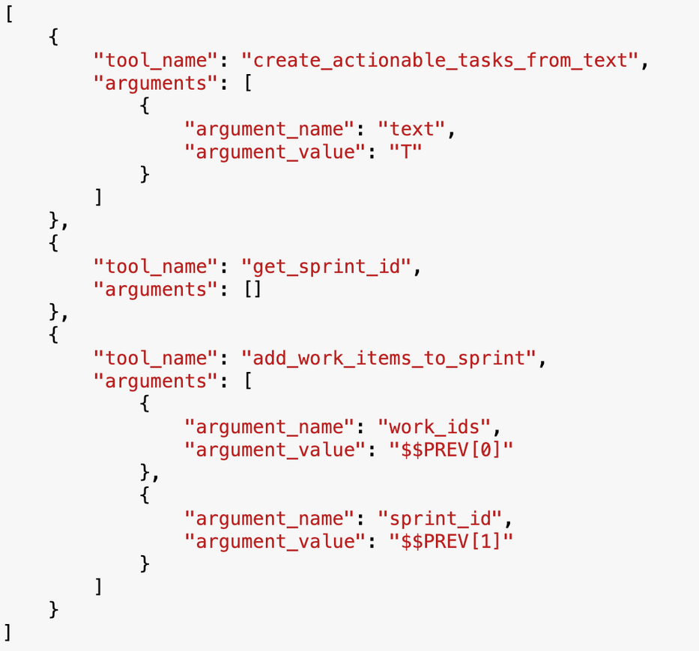
Our Results
Desired Results
“Given a customer meeting transcript T, create action items and add them to my current sprint”

Slide 19
RESULTS
Queries | BLEU-5_scores
"Get all work items similar to TKT-123, summarize them, create issues from that summary, and prioritize them” | 0.9439792470039666
"Given a customer meeting transcript T, create action items and add them to my current sprint” | 0.8101603728876992
“What is the meaning of life?” | 1
“Summarize issues similar to don:core:dvrv-us-1:devo/0:issue/1” | 0.30758791229866156
“ What are my all issues in the triage stage under part FEAT-123? Summarize them.” | 0.08625054732417066
"Prioritize my P0 issues and add them to the current sprint” | 0.02028532871972705
"List all high severity tickets coming in from slack from customer Cust123 and generate a summary of them” | 0.01547275259922056
Notes:
For evaluating our model we used BLEU Score(measures the similarity of the machine-translated text to a set of high quality reference translations)

Slide 20
FUTURE GOALS
Two possible strategies:
Using the sliding window of varying sizes for exploring word-level subqueries to capture tools associated with each word.
To find tool dependencies and relationships, we could use knowledge graphs.

Slide 21
THANK YOU!

